Slide 1
SYRIA TEL CUSTOMER CHURN ANALYSIS.
MORINGA SCHOOL
PHASE 3 PROJECT
MERCY CHEPKORIR

Slide 2
Outline
Business Understanding
Data Understanding
Data preparation
Model fitting
Model prediction
Model evaluation
Conclusion and recommendation

Slide 3
Business Understanding
In the highly competitive telecom industry, retaining existing customers is significantly more cost effective than acquiring new ones. SyriaTel aims to reduce customer attrition by analyzing both business and customer behavior data. A thorough understanding of the domain helps identify the key drivers of churn and informs the development of a predictive model to support data-driven retention strategies.
Stakeholders
SyriaTel executive shareholders that’s the board of directors and senior management of the syriaTel telecommunication company.

Slide 4
Business Problem
The business problem is to analyze customer behavior, identify churn patterns and build a predictive model capable of detecting customers likely to leave.
Predicting which customer is likely tyo leave the company will enable telecom companies like SyriaTel to take proactive steps toward improving customer retention.

Slide 5
Data Understanding
Data Source
The data for the project was obtained from the Kaggle website:
https://www.kaggle.com/datasets/becksddf/churn-in-telecoms-dataset.
This dataset consists of a single csv file: bigml.csv , it contains information on 3,333 customers of the telecommunications company "SyriaTel."
It features 20 attributes, including customer demographics, call usage patterns during different times of the day, and subscription details such as voice mail and international plans. The account length attribute indicates how long a customer has been with SyriaTel, offering a valuable measure of their lifetime value.

Slide 6
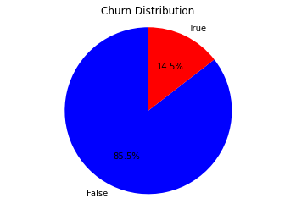
Customer Churn Distribution
From our pie chart we see that 14.5 % of customers churn and 85.8% don’t churned.

Slide 7
Data preparation , Analysis and Modelling
Data was read into python using pandas
Data was manipulated and cleaned
Data analysis was conducted
Data visualization was done
Feature Engineering was also done with MinMaxer Scaler
Prediction was made using the logistic regression and decision tree model
Evaluation of the model was done using accuracy score and classification matrices

Slide 8
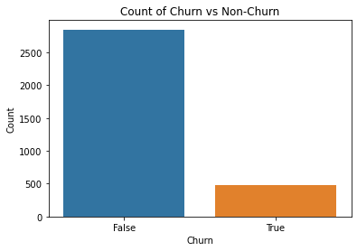
Results 1- Desciptive Analysis

Slide 9
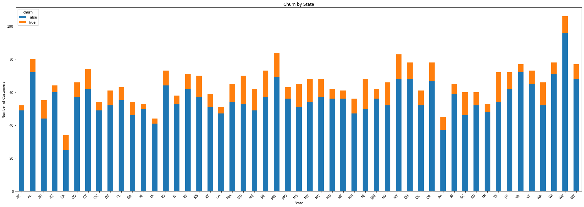
Results 2- Desciptive analysis 2

Slide 10
Modeling – Logistic regression
The Logistic Regression model used in this context, with balanced class weights, has shown a good ability to predict customer churn. It has an accuracy of approximately 77%, and the ROC curve indicates a good balance between sensitivity and recall. The confusion matrix shows that the model has a higher number of false positives, indicating that it tends to predict churn where there isn't any. However, it's better to predict potential churn and take preventive measures than to miss out on customers who might churn. The discrimination threshold plot can be used to adjust the threshold for predicting churn to balance precision and recall as per business requirements.

Slide 11
*Conclusion:**
The ensemble stacking model outperforms the individual models, demonstrating the highest accuracy, recall, precision, and F1 score on both test and training data.
The stacking model is recommended for its improved overall performance in predicting the target variable.

Slide 12
Recommendation
Leverage existing customer data for churn predictions: Conduct a thorough review of the available customer data, including demographics ,call history, service plans and any other relevant variables .Regularly update and refine the churn prediction model as new data becomes available to maintain its accuracy and effectiveness.
Evaluate Retention Strategies and interventions: Continuously iterate and optimize retention efforts based on the results of experiments and ongoing analysis.
Identify factors driving customer churns: Utilize statistical methods and machine learning techniques to identify the most significant drivers to churn.
Segment Customers and tailor retention strategies: Continuously monitor and analyse the effectiveness of retention strategies for each segment, adjusting tactics as needed based on evolving customer dynamics.

